Slide 1
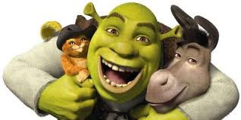
Predicting Prison Rule Violations

Slide 2
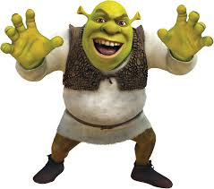
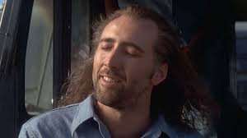
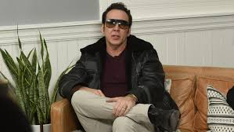
The Team
Ben Branchflower
Joseph Young

Slide 3
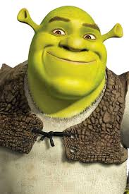
Motivations
Similar question to recidivism
Could help with prison security
The population is interesting

Slide 4
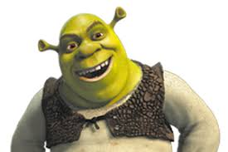
Past Research
Forecasting
Uses OLS, Additive Regression, Decision Stumps
K Means Clusterning, Kernal Density Estimation, Support Vector Machines
Deep Learning — Forecasting by Location
Classification
Deep Learning— Facial Feature Analysis, Forecasting by Location
Notes:
2015 http://airccse.org/journal/mlaij/papers/2115mlaij01.pdf, 2017 https://journals.plos.org/plosone/article?id=10.1371/journal.pone.0176244

Slide 5

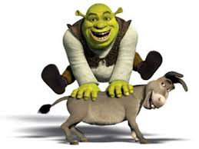
Data
Survey of Inmates in State and Federal Correctional Facilities, 2004
Approx. 18000 Observations
Approx. 3300 Features

Slide 6
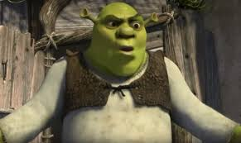
Preliminary “Important” Features
Duration of time spent in Prison
Whether or not the Inmate had been Raped or Abused prior to entering Prison
The age/relationship of the abuser
Drug History
Mental Disorders
Probation Violator
Marital Status
Whether or not a toy BB Gun was involved in their Crime

Slide 7
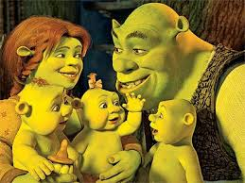
Specifications
General Set
Fresh Inmates Set
Race Omission Set

Slide 8
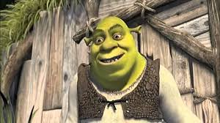
Preparation
Cleaning Required:
Removed Upwards of 2500 Features
Feature Engineering
Handling large amounts of missing data

Slide 9
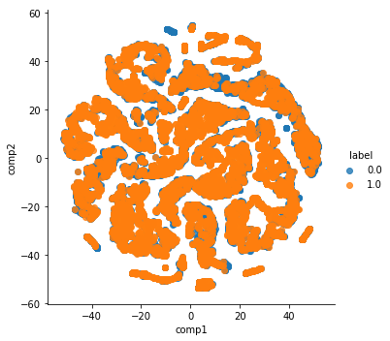
There is some separation but it does not seem to be differentiating between people that violated the prison rules and those that did not.

Slide 10

Modelling
Models Used:
AdaBoost (Uses Decision Stumps)
K Nearest Neighbors
Random Forest
XGB

Slide 11
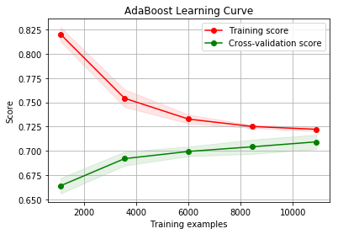
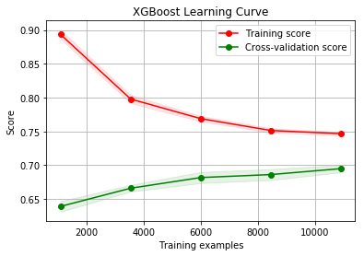

Slide 12
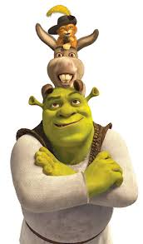
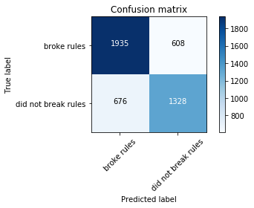
Results (F1 Scores: Macro Averages)
 | General Specifications
AdaBoost | 0.71
XGBoost | 0.70
Random Forest | 0.68
K Nearest Neighbors | 0.65

Slide 13
 | Drug Possession | Alcohol Possession | Weapon Possession | Stolen Property | Possession of Unauthorized Materials | Verbal Staff Violations
AdaBoost | 0.58 | 0.56 | 0.54 | 0.52 | 0.54 | 0.53
XGBoost | 0.57 | 0.55 | 0.56 | 0.51 | 0.56 | 0.55
 | Physical Inmate Violations | Attempted Escape | Being Out of Place | Disobeying Orders | Major Violation | Minor Violation | Physical Staff Violations
AdaBoost | 0.57 | 0.50 | 0.53 | 0.63 | 0.51 | 0.49 | 0.53
XGBoost | 0.59 | 0.50 | 0.58 | 0.62 | 0.53 | 0.51 | 0.55

Slide 14
Without Race
 | Precision | Recall | F1 Score
No Violation | 0.76 | 0.80 | 0.78
Violation | 0.72 | 0.68 | 0.70
average |  |  | 0.74

Slide 15
New Inmates Predictions
 | Precision | Recall | F1 Score
No Violation | 0.92 | 0.96 | 0.94
Violation | 0.88 | 0.77 | 0.82
average |  |  | 0.88

Slide 16

Future Steps
Better Feature Engineering
Compare first time offenders to recidivist to identify a proclivity reoffend
Use Datasets from other Years
Find most Realistic Features that can be acquired prior to prison entry

